Slide 1

Smart Traffic Management System : Project Report
By Group 15
Jeffin George Johnson
Navin Shaju
Naveen M R
A N Mohammed Shinas
Project Guide: Ms. Shyama Sreekumar

Slide 2
Objectives:
To detect sirens of emergency vehicles from noisy environments differentiating them from background noise.
Design and implementation of a Python based Machine Learning Program.
Model a Raspberry- Pi to microcontroller interface to control traffic junctions.

Slide 3

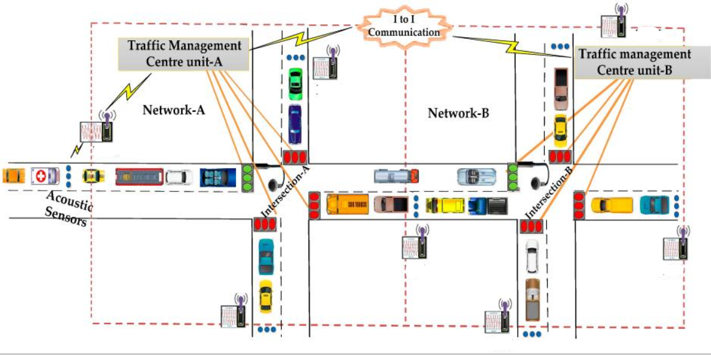
Project Overview:

Slide 4

Block Diagram:
Acoustic Sensor
(Unidirectional Microphone)
ADC
ESP8266
WiFi module
Amplifier
Raspberry Pi
Microcontroller
Traffic Signals

Slide 5
Methodology:
Siren Detection using Artificial Neural Networks and Machine learning Algorithms

Slide 6
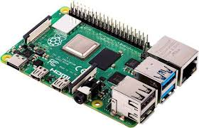
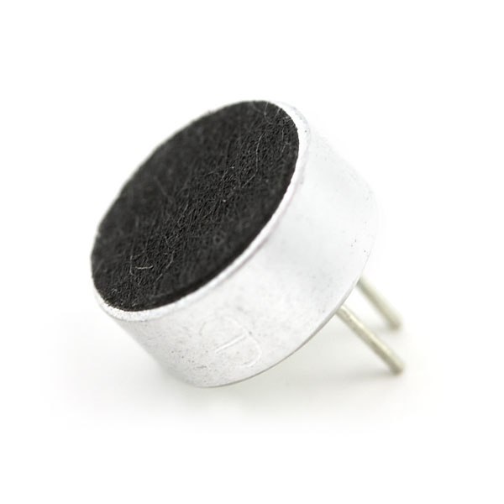


Hardware Overview:
Raspberry Pi Model 4B
Wi-Fi Module - ESP8266
Microphone (Electret)
OpAmp
Microcontroller

Slide 7
Software Overview:
Python 3.7
Arduino IDE

Slide 8
Work Flow:
1. Setting up of Raspberry-Pi
2. Training of Artificial Neural Network using the required recorded sound files.
3. Setting up of Microphone and Amplifier Circuit.
4. Interconnection of Wi-Fi Module to Raspberry Pi
5. Setting up of 4-way Traffic Light Junction model.
6. Real-Time Detection

Slide 9
Detection by Training Artificial Neural Networks
Artificial Neural Network - series of algorithms , recognizes relationships in a set of data, mimics the way the human brain operates.
Machine Learning - method of data analysis, automates analytical model building , learn from data, identify patterns and make decisions.

Slide 10
Detection Using Artificial Neural Networks
Siren Identification Systems can be created using Artificial Neural Networks such as Multi-layer perceptron(MLP).
They can be trained using Backpropagation(BP) Algorithm.
Implementation of a neural network includes:
i. Training
ii. Learning/Validation
iii. Testing

Slide 11
Detection by Training Artificial Neural Networks
In the training phase extracted features of training dataset are provided as input.
In the validation phase validation dataset is used to evaluate the performance of the trained model.
Finally in testing phase unknown audio signal is passed through the trained network to obtain the corresponding output.

Slide 12
Feature Extraction From Sirens:
Selection of features is a key issue when designing an effective signal detector.
Each time frame, requires features that comprise the essence of information relevant to classification, are robust to variations in the signal and to noise, and are efficient in terms of computational and space complexity.
To find such features, a large set of features that were previously used for different tasks of audio processing are used. There are 3 categories:
Time domain features
Frequency domain features
Wavelet-based features

Slide 13

Implementation in Python using Raspberry-Pi
2 separate python programs were implemented:
To Train and Evaluate the Neural Network
To Execute Real time detection
2 sets of data used for training and evaluation:
Emergency Sounds
Non-Emergency Sounds
The dataset is pre recorded for training. 70 % of the dataset used for training & 30 % for evaluation
Threshold values of probability can be set to improve accuracy

Slide 14
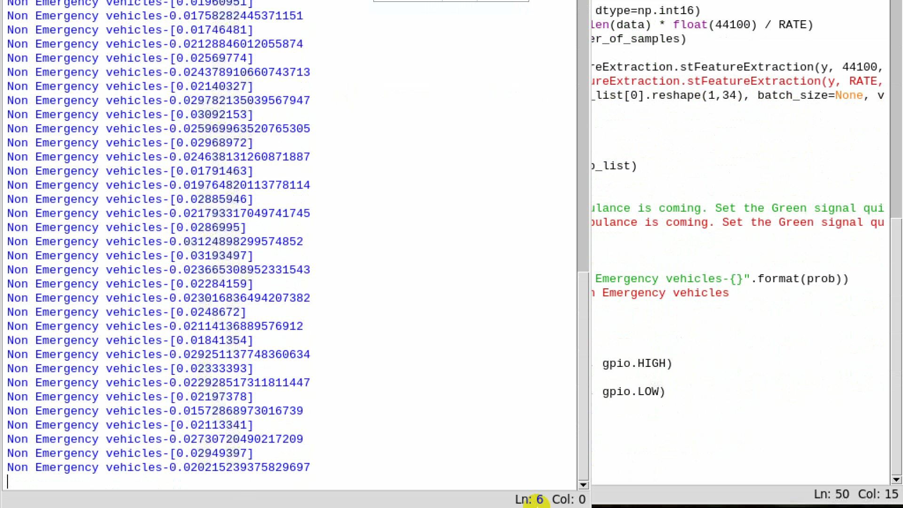
Software Simulation:

Slide 15
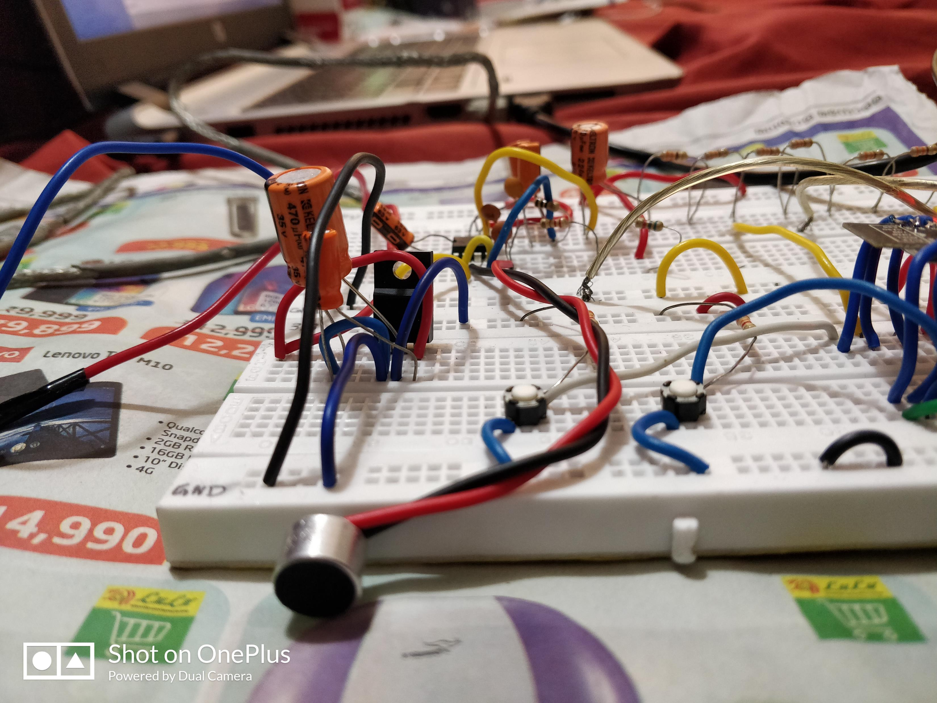
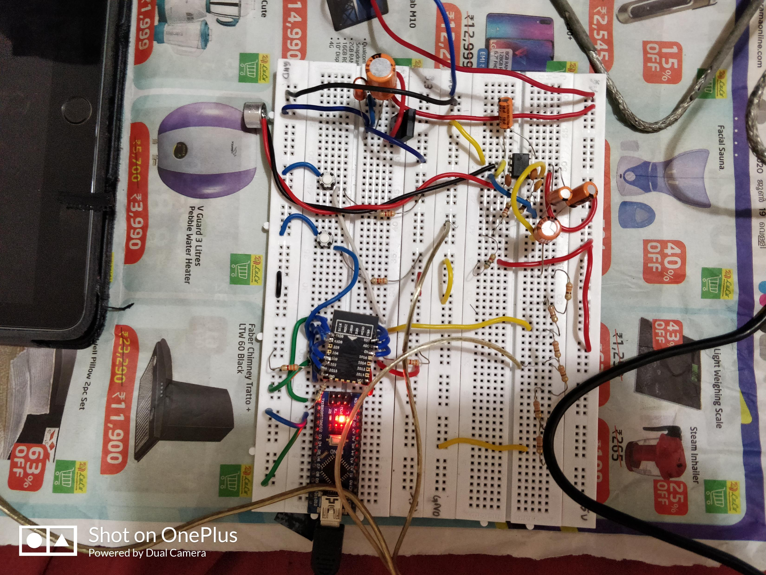
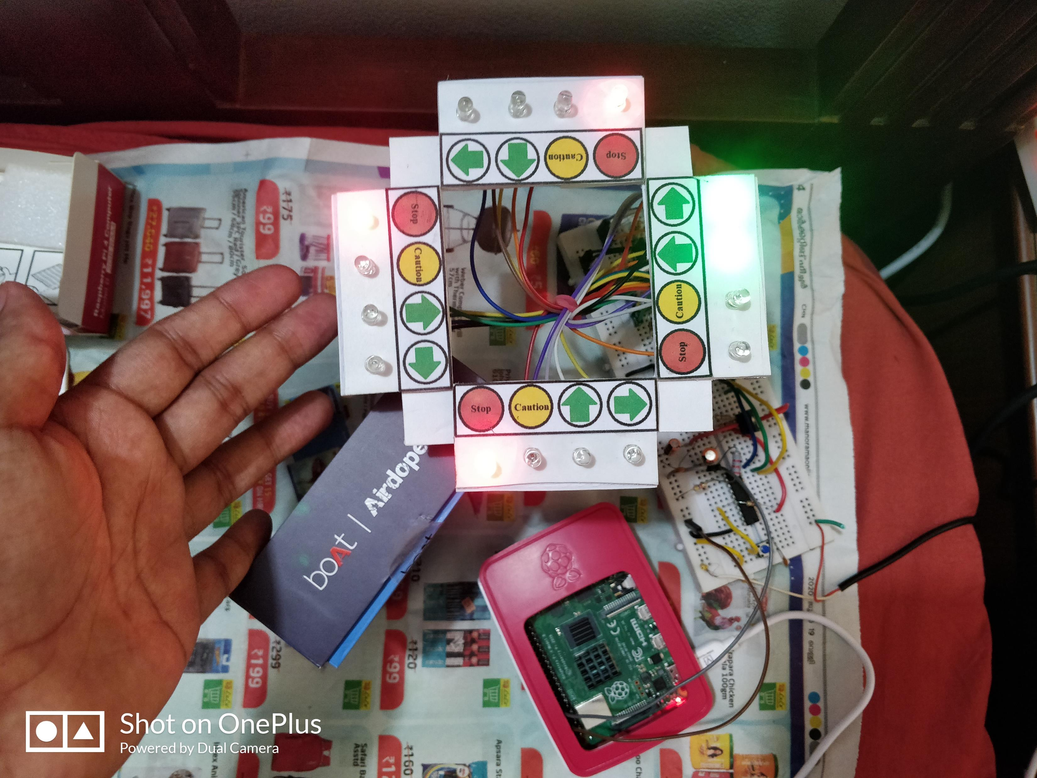
Result & Observations:

Slide 16
Video Demonstration:

Slide 17
Advantages:
High Accuracy (98% per 100 ms audio frame)
Robustness to noise & low amplitude signals
Large Flexibility in training data; Can be used for various sirens;
Not affected by Doppler Effect.
Very low time delay (500 ms)

Slide 18
Future Scope:
Implementation on a 4-Way Traffic junction and an IOT-based Inter-Junction Communication Network

Slide 19
Work Division:
A N Mohammed Shinas | Traffic Light System Setup and Control
Naveen M R | Training & Testing of Artificial Neural Network
Navin Shaju | Microphone & Wi-Fi Module Setup and Control
Jeffin George Johnson | Raspberry Pi 4 Computer Setup and Control

Slide 20
References:
Dean Carmel, Ariel Yeshurun, Yair Moshe Signal and Andrew and Erna Viterbi; “Detection of Alarm Sounds in Noisy Environments”; Image Processing Laboratory (SIPL) Faculty of Electrical Engineering, Technion – Israel Institute of Technology; IEEE-2017 - 25th European Signal Processing Conference (EUSIPCO);
Van-Thuan Tran, Yu-Cheng Yan, Wei-ho Tsai ; “Detection Of Ambulance And Fire Truck Siren Sounds Using Neural Networks”; Department of Electronic Engineering, National Taipei University of Technology, Taiwan; Proceedings of 51st Research World International Conference, Hanoi, Vietnam, 26th -27th July 2018;
Takuya Miyazakia , Yuhki Kitazonoa , Manabu Shimakawab; “Ambulance Siren Detector using FFT on dsPIC”; Proceedings of the 1st IEEE/IIAE International Conference on Intelligent Systems and Image Processing 2013;

Slide 21
Kadar Muhammad Masum, A., Kalim Amzad Chy, M., Rahman, I., Nazim Uddin, M., & Islam Azam, K. (2018). An Internet of Things (IoT) based Smart Traffic Management System: A Context of Bangladesh. 2018 International Conference on Innovations in Science, Engineering and Technology (ICISET).
Rohini Priya P., Anju Joy J., Sumathy G; “ Traffic light pre-emption control system for Emergency vehicles.”; SSRG Int. J. Electron. Commun. Eng. 2015; 2:21–25.
Sandhya, K. S., & Karthikeyan, B. (2017). ”Automatic traffic diversion system using traffic signals.” 2017 International Conference on Nextgen Electronic Technologies: Silicon to Software (ICNETS2).

Slide 22
The End

Slide 23

Appendix – Python Code

Slide 24

# Import the libraries
# Python's in-built modules
import os
import glob
import time
# External modules
import numpy as np
import pandas as pd
from tqdm import tqdm
# Librosa for audio
import librosa
import librosa.display
# For designing the band-pass filter
from scipy.signal import butter, lfilter, hilbert
# Plotting modules
import matplotlib.pyplot as plt
import matplotlib.style as ms
import matplotlib.ticker as ticker
import seaborn as sns
sns.set_style("whitegrid")
import matplotlib.gridspec as gridspec
# Pyaudionalaysis functions
from pyAudioAnalysis import audioBasicIO
from pyAudioAnalysis import audioFeatureExtraction
# Scikit-learn modulesfrom sklearn.preprocessing import StandardScaler
from sklearn.model_selection import train_test_split
from sklearn.utils import shuffle
from sklearn.externals import joblib
from sklearn.metrics import confusion_matrix
# Keras and TensorFlow modules
from keras.models import Sequential
from keras.layers import Dense
from keras.callbacks import EarlyStopping
from keras.models import load_model
import tensorflow as tf
from keras.backend import common as K
K.set_image_dim_ordering('th')
# Supress Tensorflow error logs
os.environ['TF_CPP_MIN_LOG_LEVEL'] = '3'
# fix random seed for reproducibility
from numpy.random import seed
seed(1)
import tensorflow
tensorflow.random.set_seed(2)
Training & Evaluation

Slide 25
def butter_bandpass_filter(data, lowcut=500, highcut=1500, fs=8000, order=5):
'''
Bandpass filter to remove noise
Helps the algorithm to focus only on the relevant frequency band
'''nyq = 0.5 * fs
low = lowcut / nyq
high = highcut / nyq
b, a = butter(order, [low, high], btype='band')
y = lfilter(b, a, data)
return y
def preprocess(y):
'''
Extracts the envelope of the audio signal
'''
y_filt = butter_bandpass_filter(y)
analytic_signal = hilbert(y_filt)
amplitude_envelope = np.abs(analytic_signal)
return amplitude_envelope
def read_files(files):
X = []
for fn in tqdm(files):
y, sr = librosa.load(fn, sr=8000)
y = preprocess(y)
features = audioFeatureExtraction.stFeatureExtraction(y, sr, 0.10*sr, .05*sr)
X.extend(features)
return X
def get_data(path_em, path_nonem):
# # Make the data file path user defined
# path_em = '../data/balanced/cleaned_emergency/'
# path_nonem = '../data/balanced/nonEmergency/'
em_files = glob.glob(os.path.join(path_em, '*.wav'))
nonem_files = glob.glob(os.path.join(path_nonem, '*.wav'))
print("Reading the Em class files")
X_em = read_files(em_files)
#N_em = len(em_files) # Remove data imbalance
print("Reading the Non-Em class files")
X_nonem = read_files(nonem_files)
return X_em, X_nonem

Slide 26
def build_model():
model = Sequential([
Dense(64, input_dim=34, activation='relu'),
Dense(256, activation='relu'),
Dense(256, activation='relu'),
Dense(256, activation='relu'),
Dense(1, activation='sigmoid')
])
model.summary()
model.compile(loss='binary_crossentropy', optimizer='adam', metrics=['accuracy'])
return model
def run_model(model, X_train, Y_train, X_test, Y_test):
earlystop = EarlyStopping(monitor='val_loss', min_delta=0.001, patience=10, verbose=0, mode='auto')
callbacks_list = [earlystop]
history = model.fit(X_train, Y_train, epochs=200, validation_data=(X_test, Y_test), batch_size=5000, callbacks=callbacks_list)
model.save("Trained_data.h5")
print("Saved model to disk!")
return history
def plot_model_history(model_history):
fig, axs = plt.subplots(1,2,figsize=(15,5))
# summarize history for accuracy
axs[0].plot(range(1,len(model_history.history['accuracy'])+1),model_history.history['accuracy']) axs[0].plot(range(1,len(model_history.history['val_accuracy'])+1),model_history.history['val_accuracy'])
axs[0].set_title('Model Accuracy')
axs[0].set_title('Model Accuracy')
axs[0].set_ylabel('Accuracy')
axs[0].set_xlabel('Epoch') axs[0].set_xticks(np.arange(1,len(model_history.history['accuracy'])+1),len(model_history.history['accuracy'])/10)
axs[0].legend(['train', 'val'], loc='best');
# summarize history for loss axs[1].plot(range(1,len(model_history.history['loss'])+1),model_history.history['loss']) axs[1].plot(range(1,len(model_history.history['val_loss'])+1),model_history.history['val_loss'])
axs[1].set_title('Model Loss')
axs[1].set_ylabel('Loss')
axs[1].set_xlabel('Epoch') axs[1].set_xticks(np.arange(1,len(model_history.history['loss'])+1),len(model_history.history['loss'])/10)
axs[1].legend(['train', 'val'], loc='best’);
plt.savefig('model_history.png')

Slide 27
def clip_level_prediction(model, X_test, Y_test):
Y_pred = model.predict_classes(X_test)
cm = confusion_matrix(Y_pred, Y_test)
df_cm = pd.DataFrame(cm, index = ['Non-EM', 'EM'],
columns = ['Non-EM', 'EM'])
plt.figure(figsize = (8,6))
sns.heatmap(df_cm, annot=True, cmap='YlGnBu');
plt.savefig('Clip_confusion_matrix.png')
def predict_probability(y, scaler, sr):
y = preprocess(y)
features_list = audioFeatureExtraction.stFeatureExtraction(y, sr, 0.10*sr, .05*sr)
scaler.transform(features_list)
count = 0
N = 10 # Window size
th = 0.5 # Minimum probabilty value for Em presence
model = load_model('Trained_data.h5')
prob_list = []
class_list = []
for i in range(N):
p = model.predict(features_list[i].reshape(1,34), batch_size=None, verbose=0)
p = p.flatten()
prob_list.append(p)
prob = np.mean(prob_list)
if prob > th:
#print("Em")
class_list.append(1)
else:
#print("Non-em")
class_list.append(0)
for i in range(N,len(features_list)):
prob_list.pop(0)
p = model.predict(features_list[i].reshape(1,34), batch_size=None, verbose=0)
p = p.flatten()
prob_list.append(p)
prob = np.mean(prob_list)
#print(prob)

Slide 28
if prob > th:
#print("Em")
class_list.append(1)
else:
#print("Non-em")
class_list.append(0)
return class_list
# Test Accuracy
def predict_output(y, scaler, sr):
class_list = predict_probability(y, scaler, sr)
if np.mean(class_list) > 0.5:
return 1
else:
return 0
def main():
# ## TO DO:
# Save extracted train and test data into npz or hdfs format
# train data
train_path_em = 'For_training/Emergency/'
train_path_nonem = 'For_training/nonEmergency/'
print("Training data")
Em_data, Nonem_data = get_data(train_path_em, train_path_nonem)
X_train, Y_train, scaler = prepare_data_train(Em_data, Nonem_data)
# test data
test_path_em = 'For_evaluation/Emergency/'
test_path_nonem = 'For_evaluation/nonEmergency/'
print("Test data")
Em_data, Nonem_data = get_data(test_path_em, test_path_nonem)
X_test, Y_test = prepare_data_test(Em_data, Nonem_data, scaler)
# Build the model
model = build_model()
# Run the training
history = run_model(model, X_train, Y_train, X_test, Y_test)

Slide 29
# Plot the loss and accuracy curves
#plot_model_history(history)
# Get audio clip level evaluation results
clip_level_prediction(model, X_test, Y_test)
scaler_filename = "scaler.save"
scaler = joblib.load(scaler_filename)
test_em_files = glob.glob(os.path.join(test_path_em, '*.wav'))
test_nonem_files = glob.glob(os.path.join(test_path_nonem, '*.wav'))
tot_em, correct_em, tot_nonem, correct_nonem = 0, 0, 0, 0
print("Evaluating Em class test data")
for test_file in tqdm(test_em_files):
y, sr = librosa.load(test_file, sr=8000)
classes = predict_output(y, scaler, sr=8000)
if classes == 1:
correct_em += 1
tot_em += 1
print("Evaluating NonEm class test data")
for test_file in tqdm(test_nonem_files):
y, sr = librosa.load(test_file, sr=8000)
classes = predict_output(y, scaler, sr=8000)
if classes == 0:
correct_nonem += 1
tot_nonem += 1
print("Correct Em: {}\nTotal Em: {}\nCorrect NonEm: {}\nTotal NonEm: {}".format(correct_em, tot_em, correct_nonem, tot_nonem))
print("=== EVALUTION METRICS ===")
print("Accuracy: {}".format(float(correct_em + correct_nonem)/(tot_em + tot_nonem)))
print("Precision: {}".format(float(correct_em)/(tot_nonem - correct_nonem + correct_em)))
print("Recall: {}".format(float(correct_em)/tot_em))
if __name__ == "__main__":
main()

Slide 30
# Stream audio from microphone
# Classify chunks of audio
###### Importing the libraries #######
import os
import numpy as np
import pyaudio
from scipy.signal import butter, lfilter, hilbert
from pyAudioAnalysis import audioFeatureExtraction
from keras.models import load_model
###### Data Pre-processing functions ###
def butter_bandpass_filter(data, lowcut=500, highcut=1500, fs=44100, order=5):
nyq = 0.5 * fs
low = lowcut / nyq
high = highcut / nyq
b, a = butter(order, [low, high], btype='band')
y = lfilter(b, a, data)
return y
def preprocess(y):
y_filt = butter_bandpass_filter(y)
analytic_signal = hilbert(y_filt)
amplitude_envelope = np.abs(analytic_signal)
return amplitude_envelope
#######################################
RATE = 44100
CHUNK = int(0.1*RATE)
model = load_model('model3.h5')
p = pyaudio.PyAudio()
stream = p.open(format=pyaudio.paInt16, channels=1, rate=RATE, input=True,
frames_per_buffer=CHUNK)
th = 0.5
prob_list = []
count = 0
try:
while True:
count += 1
data = np.fromstring(stream.read(CHUNK), dtype=np.int16)
y = preprocess(data)
features_list = audioFeatureExtraction.stFeatureExtraction(y, RATE, CHUNK, CHUNK)
p = model.predict(features_list[0].reshape(1,34), batch_size=None, verbose=0)
p = p.flatten()
prob_list.append(p)
if count%10 == 0:
prob = np.mean(prob_list)
if prob >= th:
print("Ambulance is comming. Set the Green signal quick- {}".format(prob))
else:
print("Non Emergency vehicles-{}".format(prob))
prob_list = [prob]
except KeyboardInterrupt:
stream.stop_stream()
stream.close()
p.terminate()
Python Code – Real Time Detection

